Slide 1
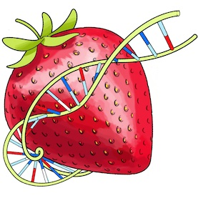
Data Visualization
Final Project – BerryVis

Slide 2
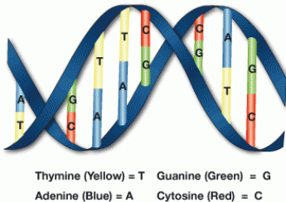
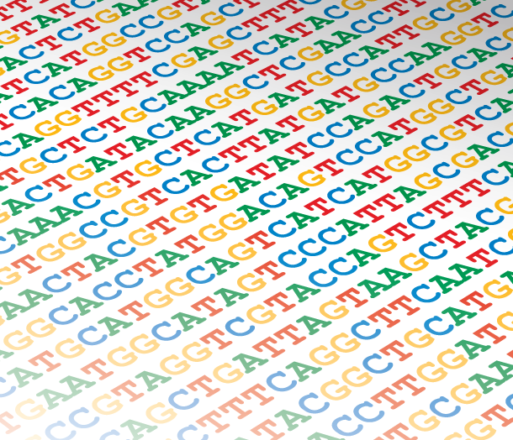
Visualizing similarities in DNA samples

Slide 3
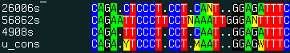
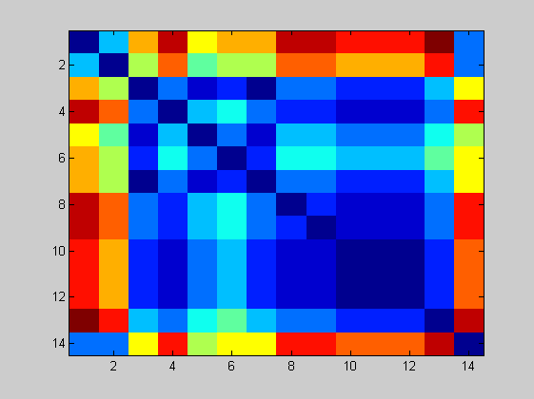
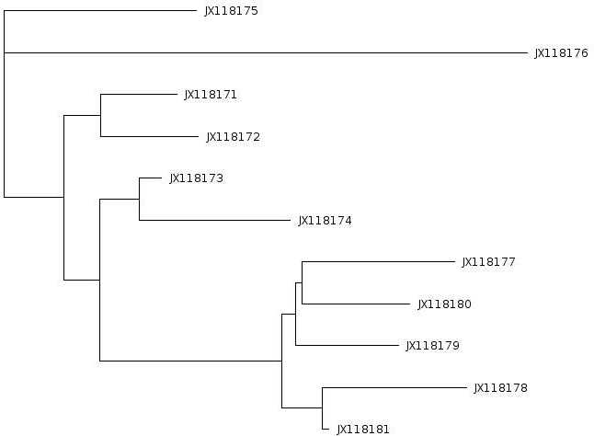
DNA sequences – finding similarities between samples
http://www.molsoft.com/man/icm-commands.html
Distance matrix
Tree view
http://www.computational-genomics.net/case_studies/sars_demo_02.png

Slide 4
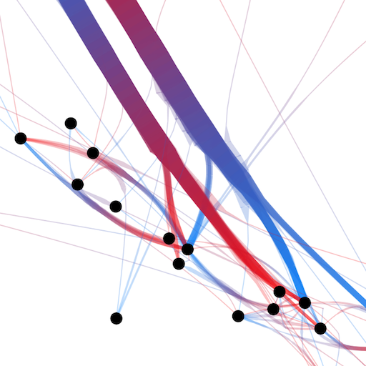
Means of visualizing the data
Classic visualization
Node-link view with colored dimension for representing distance
http://www.selassid.net/DividedEdgeBundling/bay.png

Slide 5
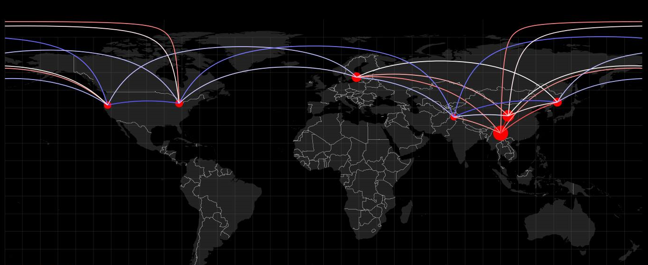


Adding more information – geographical location
Circle radius - hub weight (similarity of a sample to all others)
Blue-white-red color range for representing genetic distance

Slide 6
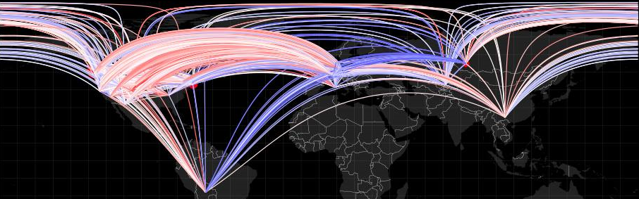
Cluttering problems
7 samples – 21 edges
270 samples – 36585 edges
Hard to distinguish and extract information.

Slide 7
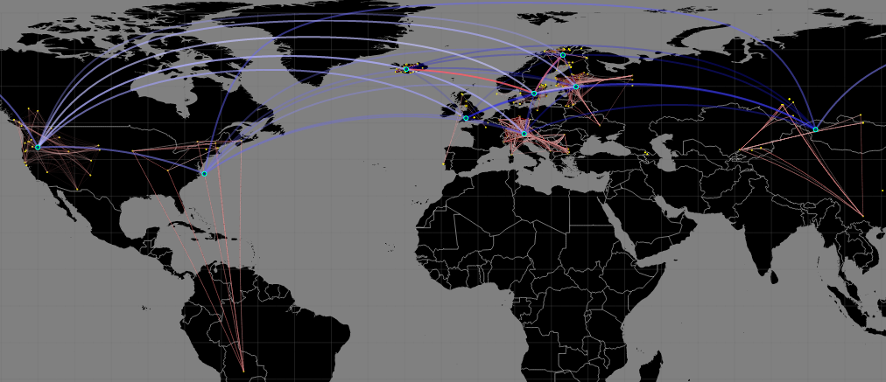
Solution Hybrid view with clustering for a hierarchical representation

Slide 8
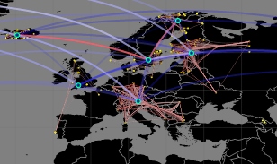
Hybrid clustering technique – hierarchical information
K-means clustering
Automatic clustering and centroid creation.
Recomputed distance matrices.
Results – Easier to perceive information in the data.

Slide 9
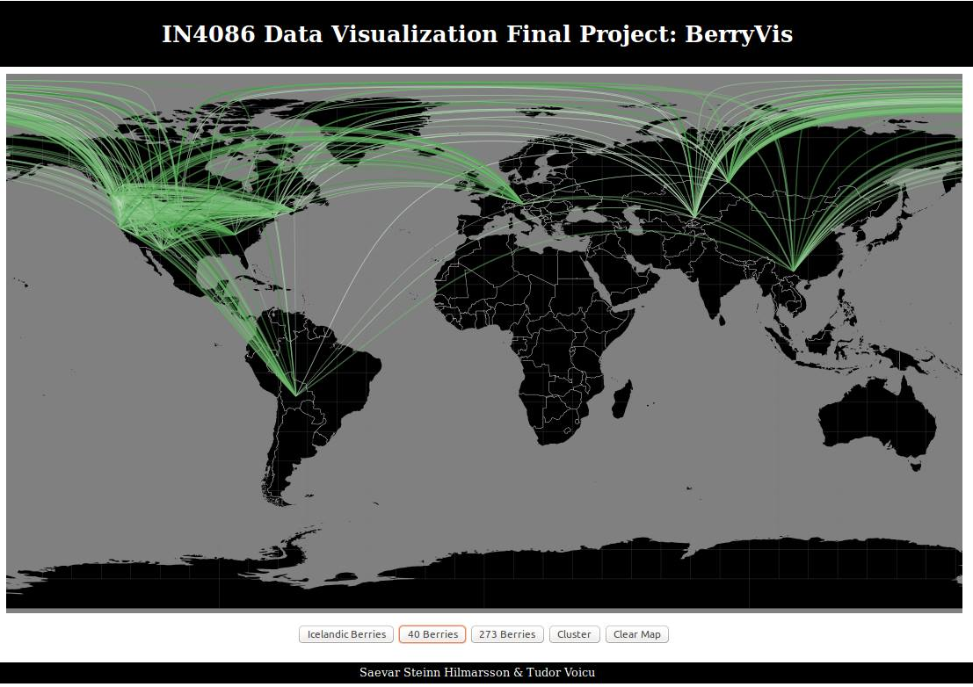

Slide 10
Thank you!
Saevar Steinn & Tudor Voicu

